Slide 1
Modeling Patient Risk
Covid-19
Shobair Abidi

Slide 2
Preliminary Setup
Notes:
Introduce the topic
hepacivirus C, West Nile virus, dengue virus, SARS and MERS coronaviruses, and SARS-CoV-2^{[2]} as well as less clinically serious pathogens such as the rhinoviruses that cause the common cold
they cause an upper respiratory tract disease,

Slide 3
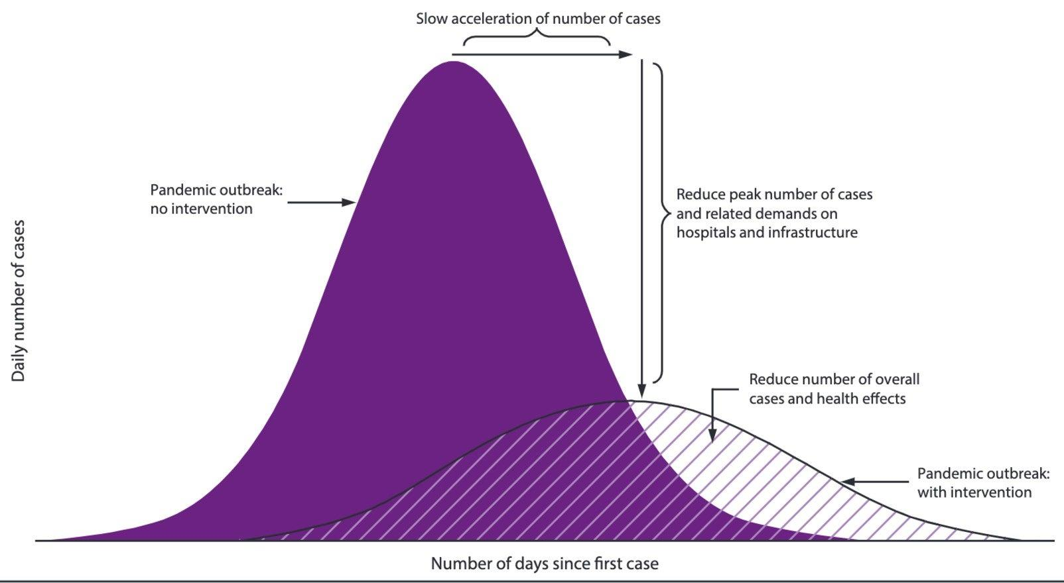
Purpose
Areas reaching max capacity
Patients Admitted
Age
Gender
Symptoms
Untreated Exposure time

Slide 4
Dataset
Defining Critical Values
Age: 50
Pre-existing conditions
Symptoms
Choosing Dataset
Model Decision
Link

Slide 5
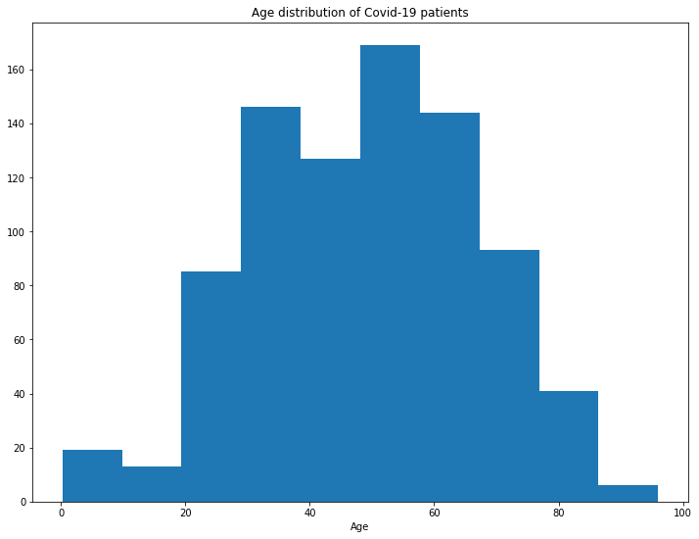
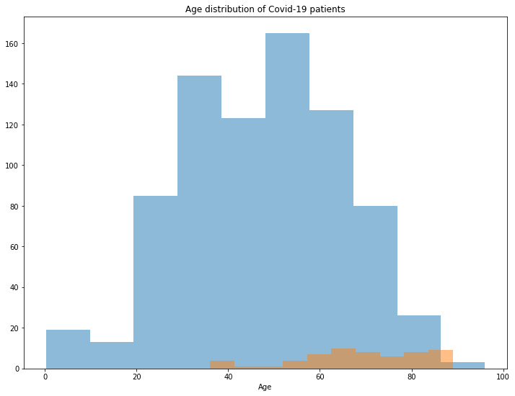
Age
Notes:
MENTION OVERSAMPLING

Slide 6
Symptoms
 | Count
No recorded symptoms | 602
fever | 459
cough | 279
pneumonia | 208
sore throat | 78
malaise | 63
myalgia | 50
difficulty breathing | 46
chill | 43
headache | 35
nasal discharge | 30
sputum | 23
diarrhea | 20
muscle pain | 17
vomiting | 12
chest discomfort | 8
flu | 6
cold | 6
nausea | 5
loss of appetite | 4
abdominal pain | 2
thirst | 2
Data Selection
Data Transformation

Slide 7
What features and symptoms stand out?

Slide 8
Model Building
Age: Categorical vs. Numeric
Gender
Symptoms
Encoding?
XGBoost

Slide 9
Feature Importance
Categorical Age | Feature_importance
pneumonia | 0.543557
gender | 0.196873
malaise | 0.093801
age | 0.048860
fever | 0.031332
myalgia | 0.028931
cough | 0.023476
sore throat | 0.017283
No recorded symptoms | 0.008089
difficulty breathing | 0.007798
Numeric Age | Feature_importance
difficulty breathing | 0.412899
myalgia | 0.375511
cough | 0.102883
sore throat | 0.076280
fever | 0.024821
pneumonia | 0.004014
gender | 0.002325
age | 0.000972
No recorded symptoms | 0.000294

Slide 10
Scoring
Num-Age | Precision | Recall | F1-score | support
0 | 0.96 | 0.93 | 0.95 | 256
1 | 0.29 | 0.44 | 0.35 | 16
Accuracy |  |  | 0.90 | 272
Macro Average | 0.63 | 0.69 | 0.65 | 272
Weighted Average | 0.92 | 0.90 | 0.91 | 272
Cat-Age | Precision | Recall | F1-score | support
0 | 0.99 | 0.77 | 0.87 | 256
1 | 0.18 | 0.81 | 0.30 | 16
Accuracy |  |  | 0.78 | 272
Macro Average | 0.58 | 0.79 | 0.58 | 272
Weighted Average | 0.94 | 0.78 | 0.83 | 272

Slide 11
Confusion Matrices
Numeric Age | Actual Recovery | Actual Death
Predict Recovery | 239 | 17
Predict Death | 9 | 7
Categorical Age | Actual Recovery | Actual Death
Predict Recovery | 198 | 58
Predict Death | 3 | 13

Slide 12
Conclusion

Slide 13
Further Work
Dataset
Untreated exposure time
More complete patient information
Extended Model building
Increased Recall
Predict Probability to use as patient risk of death

Slide 14
Questions?

